Slide 1




Credit Card Fraud Detection Using Machine Learning
Shivapriya Pillalamarri - 00905151

Slide 2


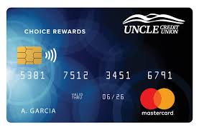

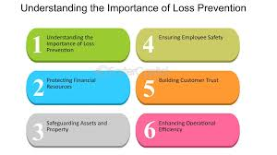
1
Credit card fraud is a growing issue globally.
2
Machine learning provides tools to detect and prevent fraudulent transactions.
3
Importance: Enhance security, reduce financial losses.

Slide 3



• Understand fraud detection challenges.
• Implement machine learning models to classify transactions.
• Minimize false positives and false negatives.

Slide 4



Dataset
1
Dataset: Credit card transactions dataset (e.g., Kaggle).
2
Features: Time, Amount, anonymized variables.
3
Imbalance: Very few fraudulent cases compared to genuine transactions.

Slide 5

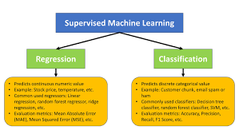
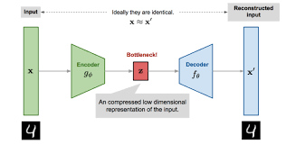

Machine Learning Techniques
Supervised learning (Logistic Regression, SVM, Random Forest, etc.).
Unsupervised learning (Anomaly Detection, Autoencoders).
Ensemble methods for improved accuracy.

Slide 6



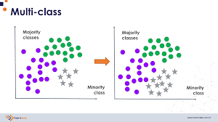
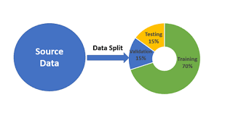
Data Preprocessing
Handling missing values.
Scaling numerical features.
Addressing class imbalance using techniques like SMOTE.
Splitting data into training and testing sets.

Slide 7


Model Evaluation
1
Metrics: Accuracy, Precision, Recall, F1-score.
2
Confusion Matrix: Analyze classification performance.
3
ROC Curve: Evaluate model's discriminatory ability.

Slide 8

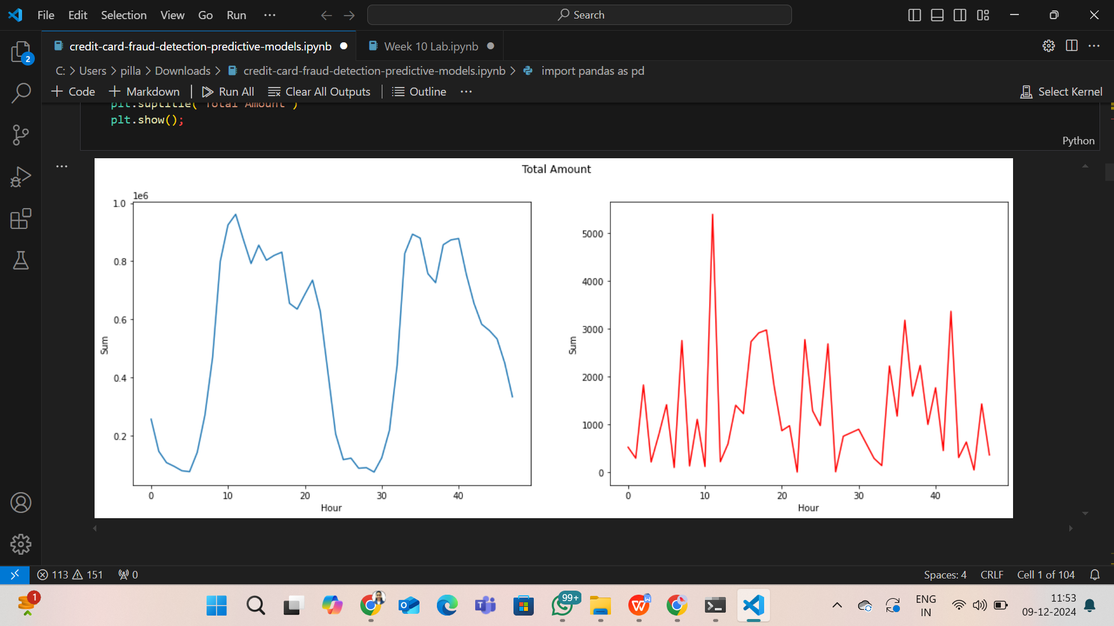
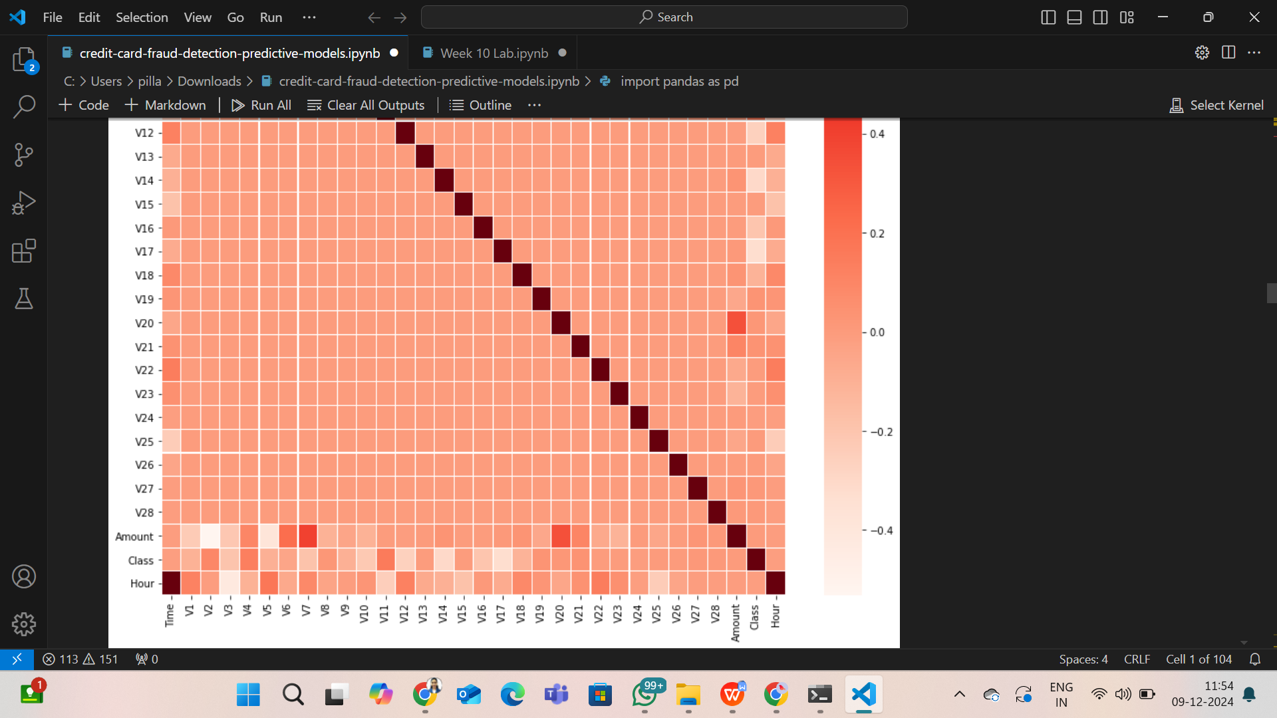
Results
High accuracy in detecting fraudulent transactions
Reduced false positives and false negatives.
Demonstration of the effectiveness of the machine learning model.
.

Slide 9
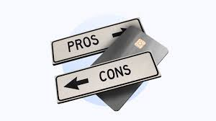
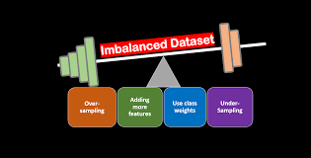
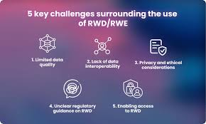
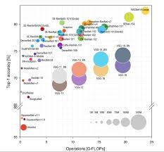
Challenges and Limitations
Imbalanced datasets leading to biased models.
Difficulty in obtaining real-world data.
Computational complexity of advanced models.

Slide 10

Future Work
Incorporate deep learning models for better feature extraction.
Real-time fraud detection.
Collaboration with financial institutions for better datasets.

Slide 11
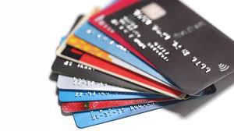
Conclusion
• Machine learning is a powerful tool for credit card fraud detection.
• Improves financial security and reduces losses.
• Continuous research and adaptation are essential to keep up with evolving threats.

Slide 12

THANK YOU

